Slide 1

Analysis of Job Market Trends in the US
Group 6

Slide 2
Questions
1. What skills are in the highest demand for data science?
2. Which industries are in the most demand in the United States?
3. What locations are hiring the most?
4. How do market trends compare over time?
5. Does experience level influence job postings?

Slide 3
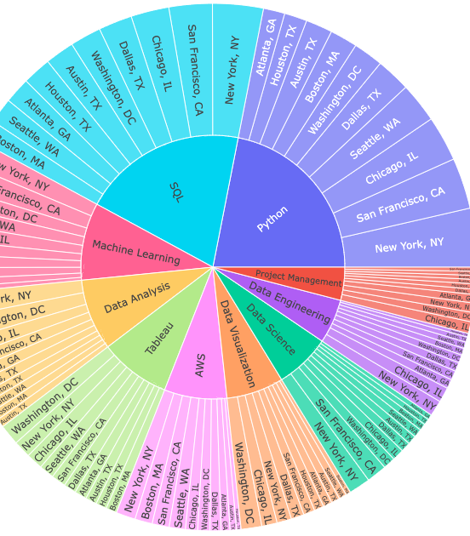
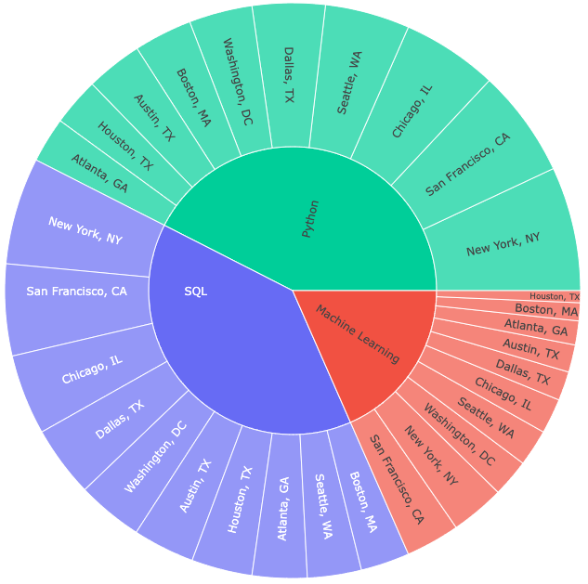
What skills are in the highest demand for data science?
Top 3 Skills in Demand:
Python 21.9%
SQL 20.1%
Machine Learning 9.4%
Top Cities for These Skills:
New York, NY: Strong demand for Python and SQL
San Francisco, CA: Strong demand for Python and SQL
Chicago, IL: Also a top location for Python and SQL
Washington, DC: Notable demand for Machine Learning
Notes:
Left: Top 10 skills from top 10 cities in 2024. (4,032 lines of data)

Slide 4
Which industries are in the most demand in the United States?

Slide 5
What locations are hiring the most?

Slide 6
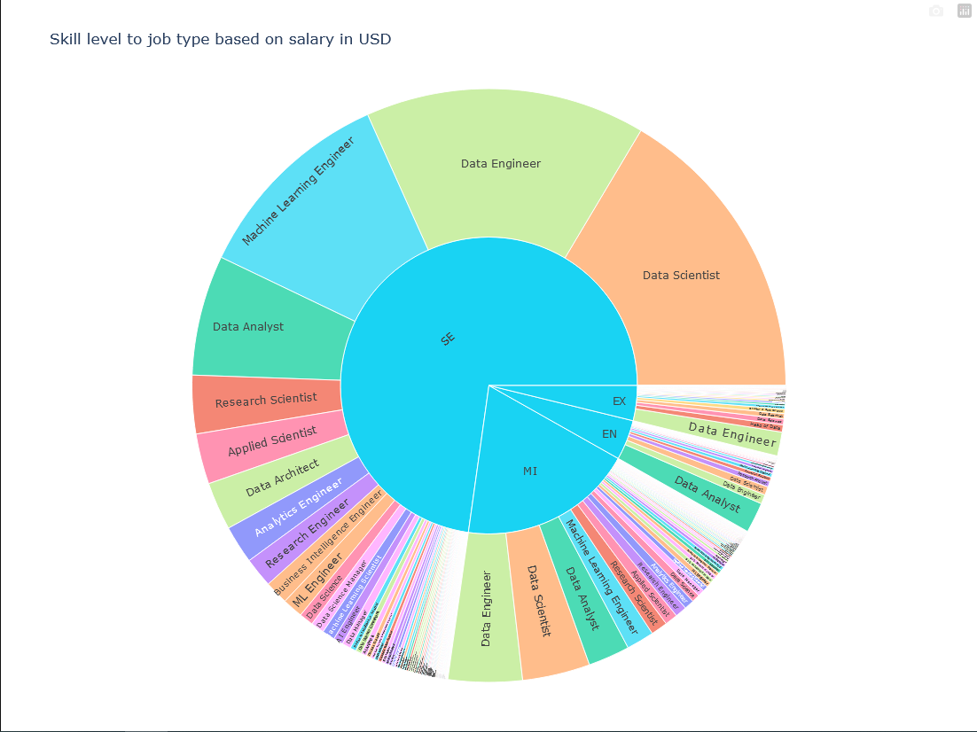
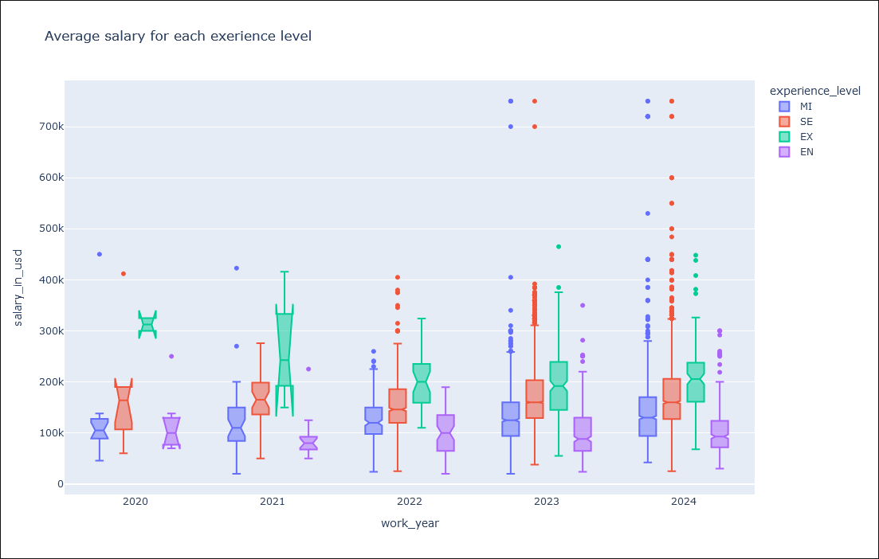
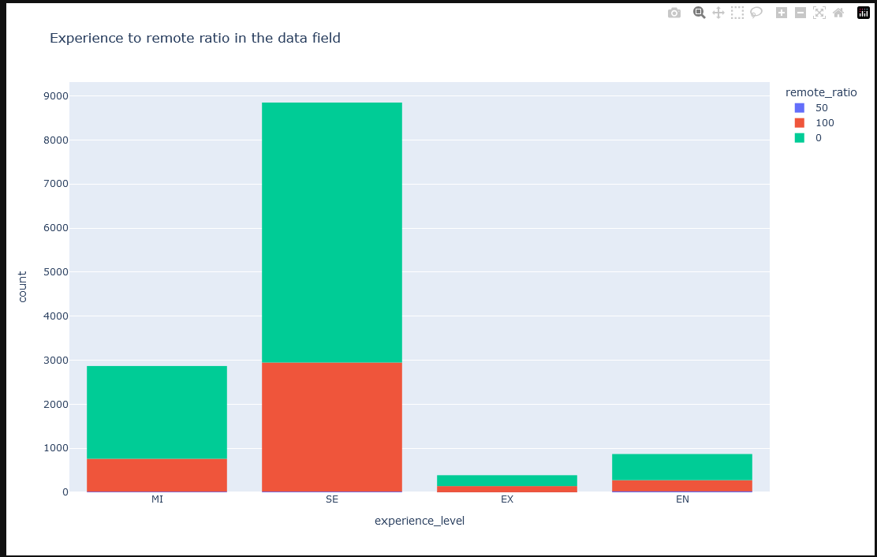
How do market trends compare over time?
The box plot show that executive, senior, and mid level average salary increased over year while entry level was staggered over the years.
Over 4 years the bar graph shows a lot more people work in office compared to remote.
The sunburst chart shows that senior level people make most of the work force, and their fields are data scientist, data engineering, and machine learning engineering.

Slide 7
What Factors influence Salary in Todays Job Market?
Age: The difference between the average salary of a 25-year-old and a 50-year-old is almost 150,000 dollars.
Experience: Based on the data collected, you are far more likely to make more money if you have more job experience.
Gender: Based on gender data in today's job market, males are paid 15% more than females.
Education: Workers with high school diplomas average around 30,000 dollars a year. Whereas workers with PhD’s are on average paid more than 100,000 dollars a year.

Slide 8
Analysis & Conclusion

Slide 9

Thank you

